Slide 1
Week 3 Class 2:
Cognitive Risk Management
INST408C: Cognitive Security | Fall 2021 | SJ Terp

Slide 2
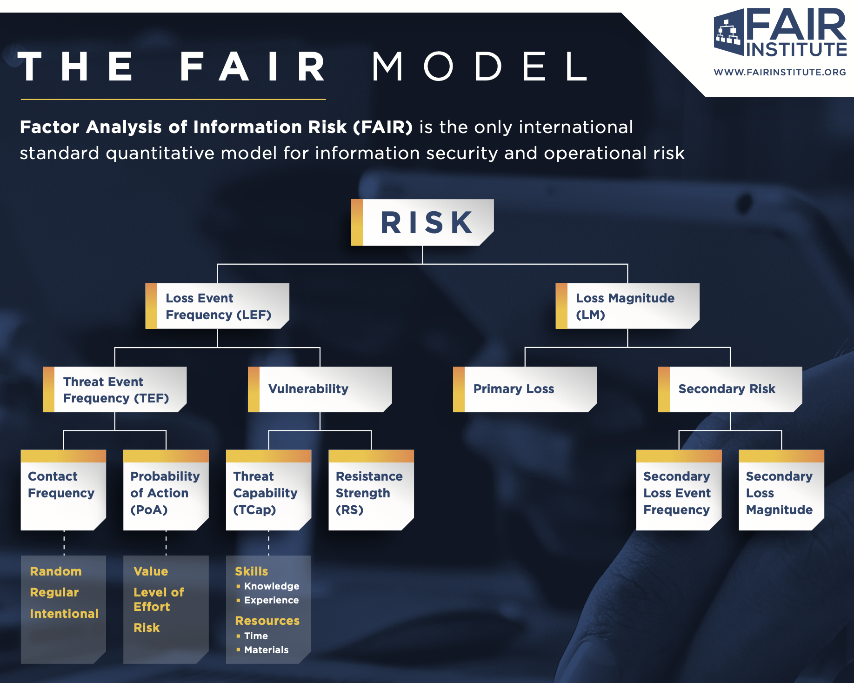
Notes:
Image: the FAIR model on one page

Slide 3
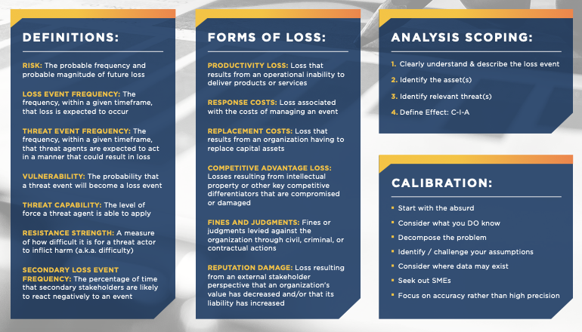
Notes:
Image: the FAIR model on one page

Slide 4
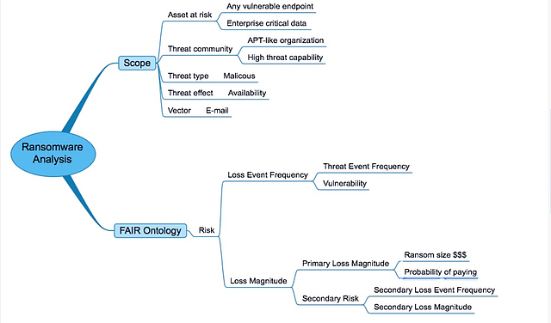
FAIR example
Notes:
Image from https://www.fairinstitute.org/blog/ransomware-risk-setting-up-a-fair-analysis

Slide 5
Information Security Risk Considerations
Digital harms and losses
Size
Reach: people, topics, time
Likelihood
Vulnerabilities
The CIA triad
Threats
Attacker goals
Stakeholders
Mitigations and response
Notes:
CIA triad:
Confidentiality: only people who are supposed to see info can see it
Integrity: only people who are allowed to change data can change it
Availability: people who are supposed to use a system can

Slide 6
Cognitive Security Risk Frameworks

Slide 7
Risk Framework Assessment
Which tradition does this come from?
Who is this framework *for* (scale, resources, timescales etc)
Does this meet what I need for:
Strategy
Risk mitigation
Incident response
Etc
Will it be used
Is it simple enough
Is it detailed enough

Slide 8
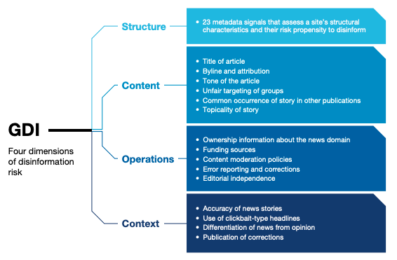
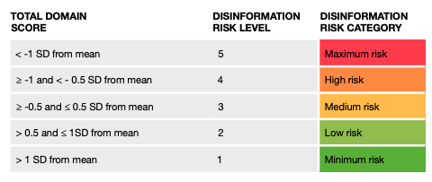
GDI: domain risk ratings
UK-based domain disinformation consultancy
Techniques rooted in infosec methods
Aimed at adtech companies
Notes:
https://disinformationindex.org/wp-content/uploads/2019/12/GDI_Index-Methodology_Report_Dec2019.pdf

Slide 9
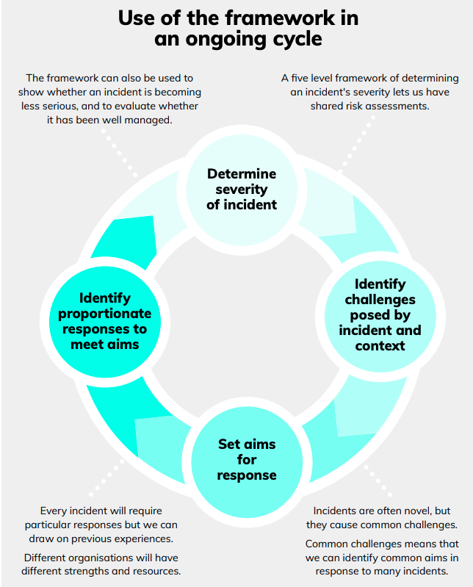
FullFact risk-levels framework
UK fact checking organisation
Techniques rooted in UN-style country assessments
Aimed at large-scale response level (region, country, international organisation, etc)
Blunt instrument
Notes:
https://fullfact.org/media/uploads/framework-information-incidents-consulation.pdf

Slide 10
Separates risk into levels
Levels:
Business as normal, no additional response needed
Monitor and prepare external facing responses
An incident is occurring, responses ramp up
An incident is occurring, coordinated responses start
Maximum response levels and cooperation required
Criteria:
Reach
Subject matter
Urgency of response
Collaboration

Slide 11
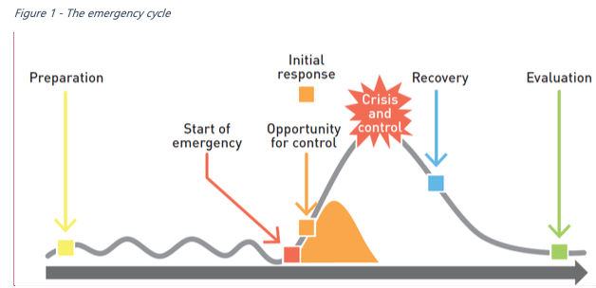
Sounds a bit like this (from WHO Europe)

Slide 12
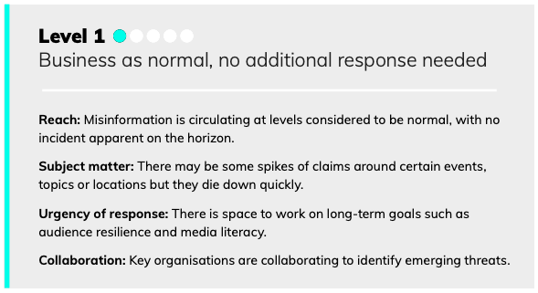
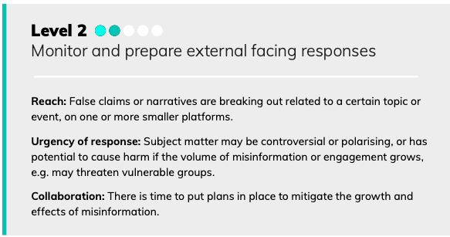
Level 1, Level 2

Slide 13
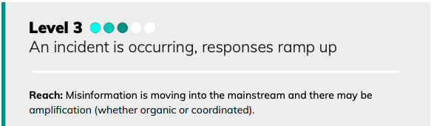
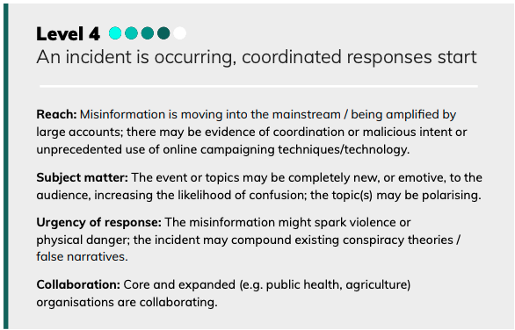
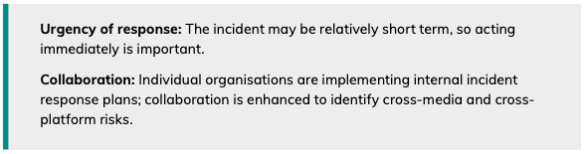
Level 3, Level 4

Slide 14
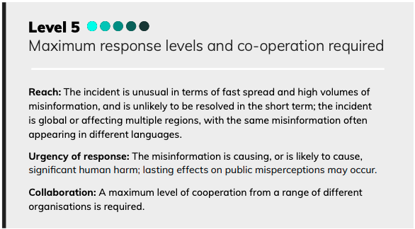
Level 5

Slide 15
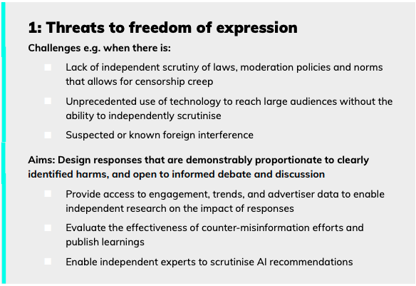
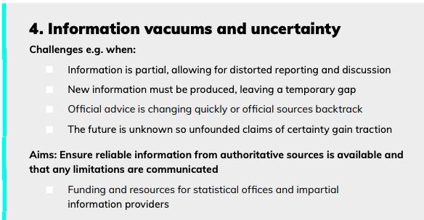
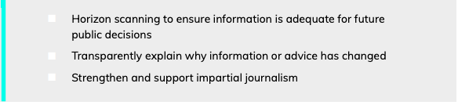
8 Challenges, including:

Slide 16
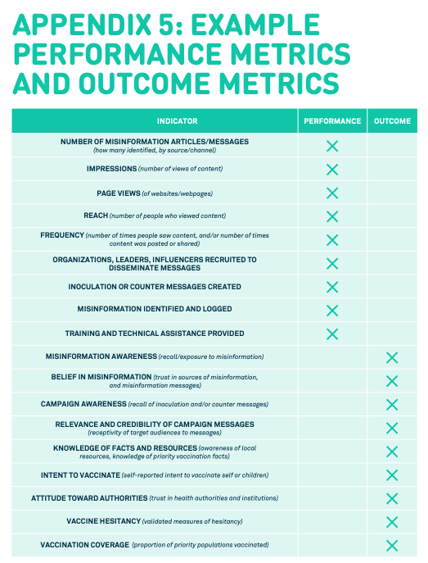
UNICEF: questions list
Large UN agency
Techniques rooted in project assessments
Aimed at individual incident responses
Features, not risks
Notes:
https://vaccinemisinformation.guide/

Slide 17
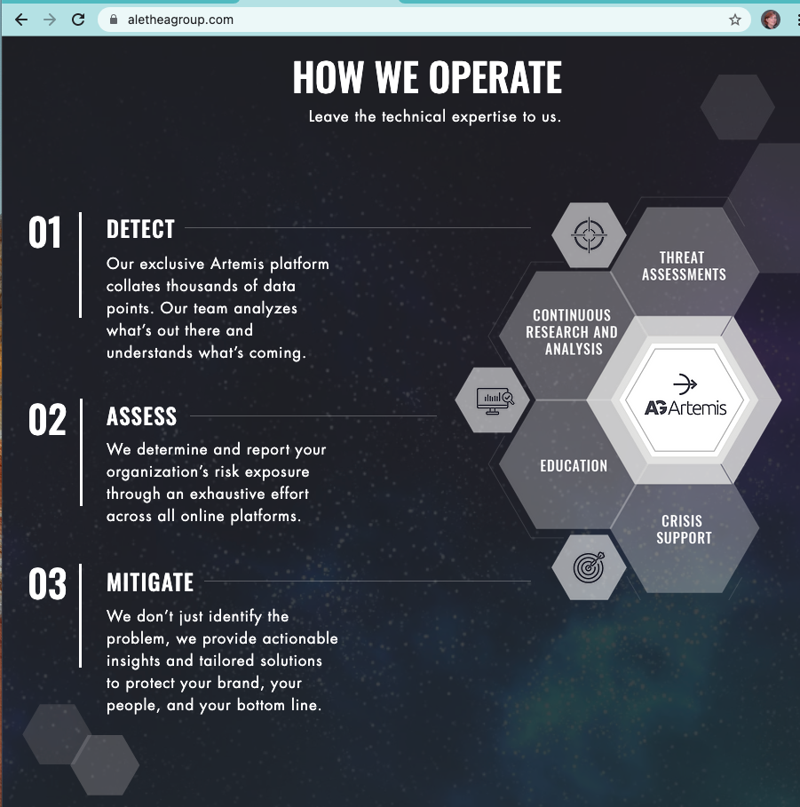
Alethea Group: threat assessments
DC-based disinformation consultancy
Techniques rooted in intelligence methods
Aimed at businesses

Slide 18
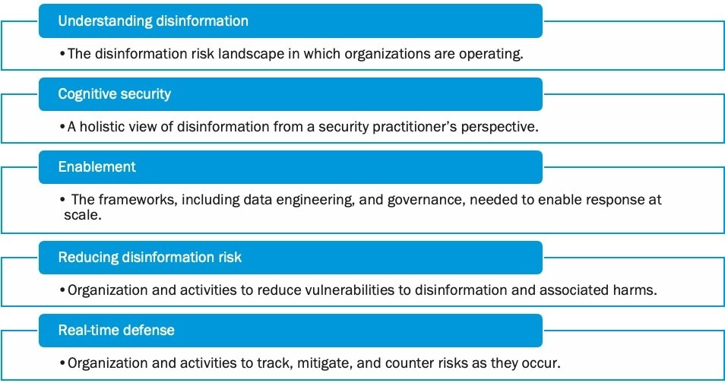
Fiveby: Adapting supply chain risk management
Seattle-based risk consultancy
Techniques rooted in fraud risk assessment
Aimed at platforms and other online businesses

Slide 19
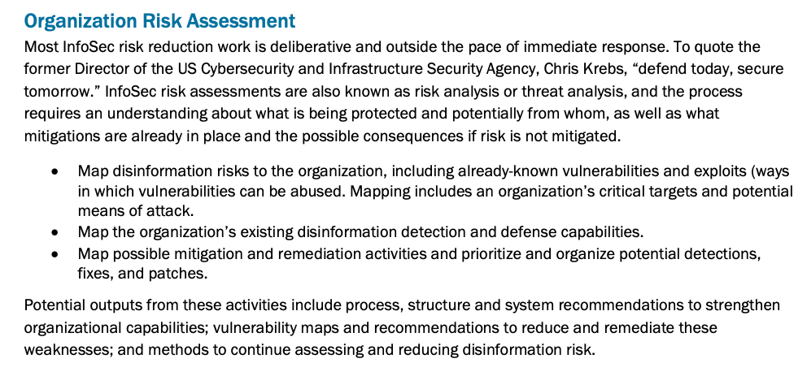
FiveBy
Notes:
fiveby.com

Slide 20
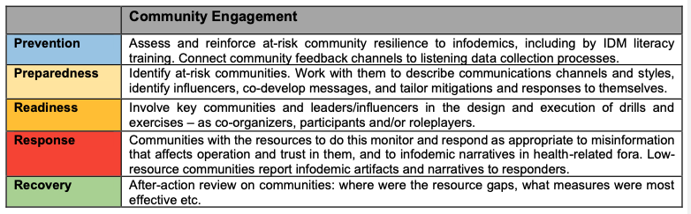
WHO Europe: full-lifecycle risk management
Large UN agency
Techniques a mix of crisis response and infosec
Aimed at regions and countries

Slide 21
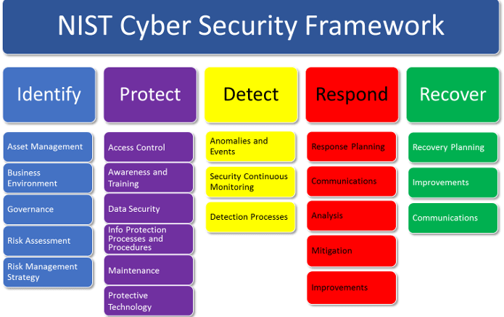
Which can look a bit like this (from infosec)

Slide 22
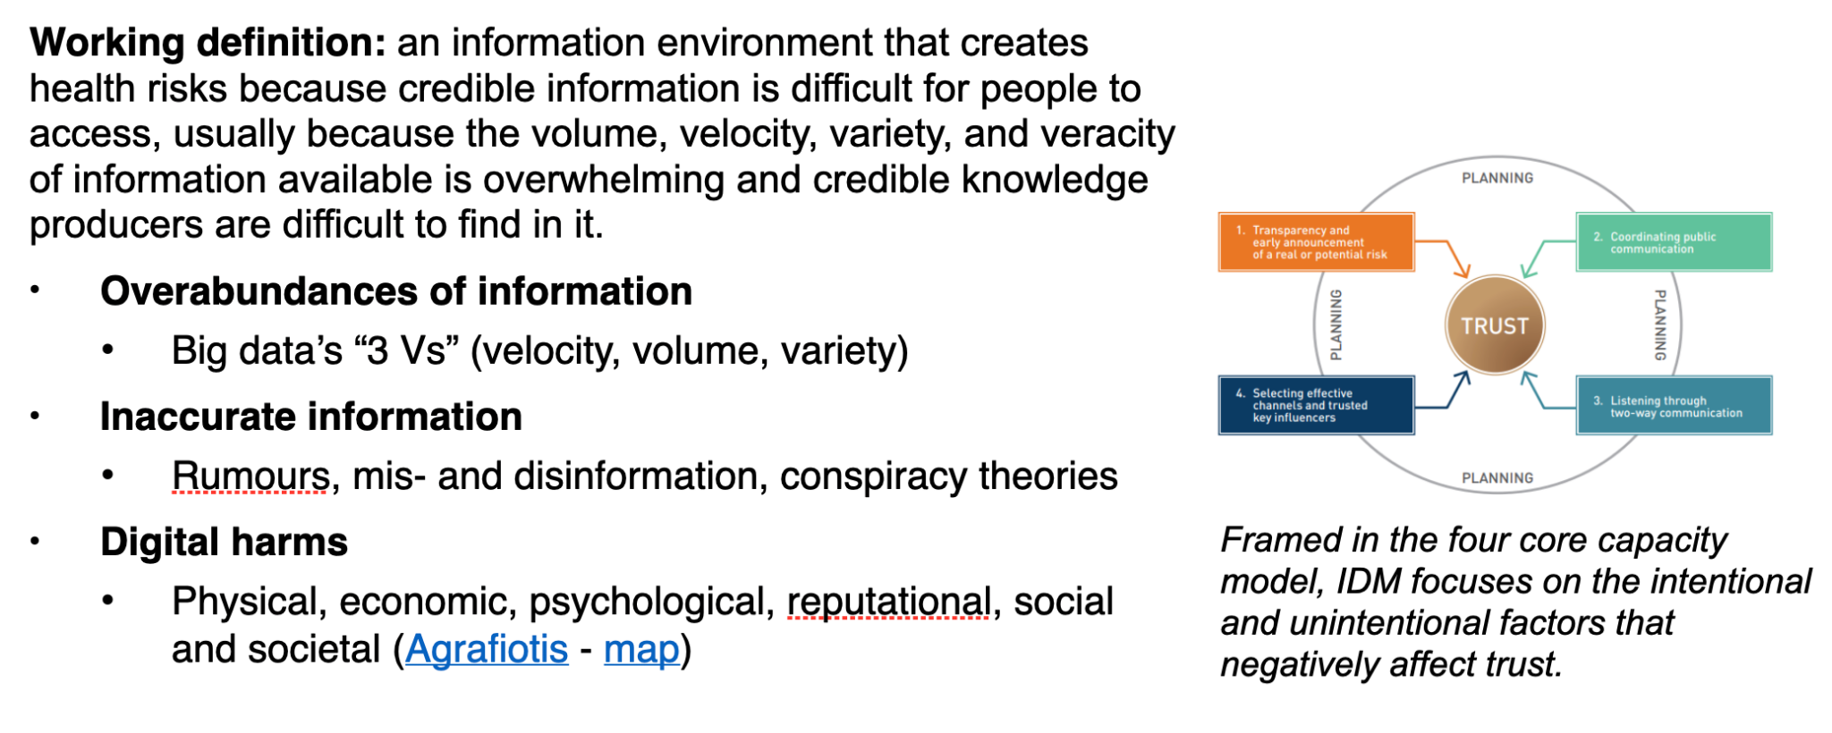
Infodemic: key harms

Slide 23
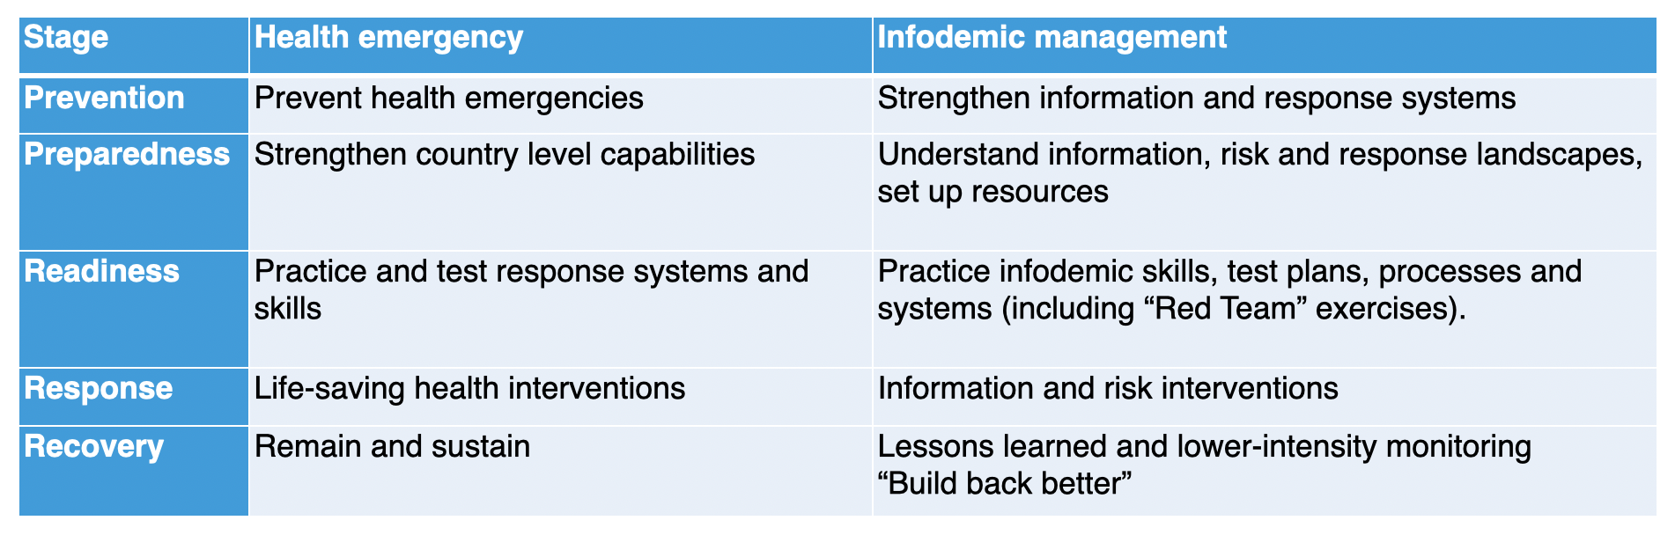
WHO crisis stages

Slide 24
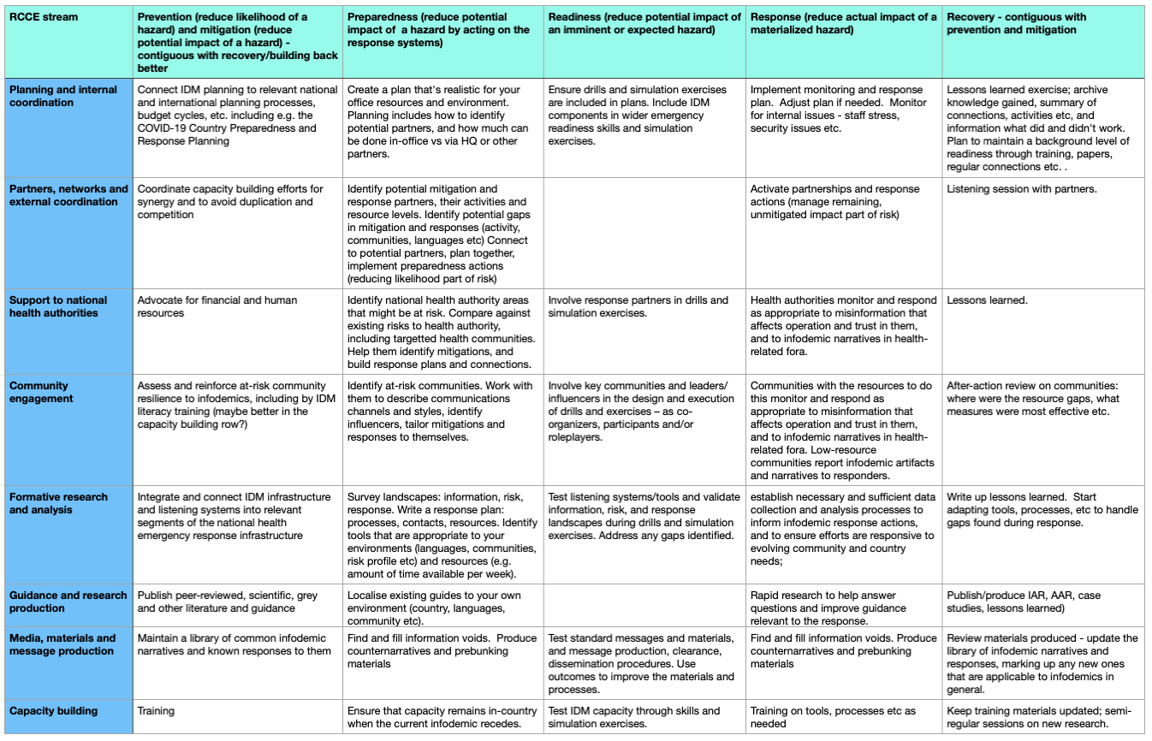

Slide 25
Week 4 Class 1:
Human System Vulnerabilities
INST408C: Cognitive Security | Fall 2021 | SJ Terp

